Slide 1

Wellness Manager 1.0
Team D: Afzal Ali, Catherine Liu, Seth Landers, Stephen Morrissey, Steve Jackling

Slide 2
Overview
Wellness manager is a program that allows for users to keep a collection of food as well as a daily log of their food intake.
The program reads in basic foods from a csv file. The user also has the option to add their own basic foods to the collection. The foods added to the collection have basic nutritional information such as calories, fat, carbohydrates, and protein which can be used to keep track of nutritional intake each day.
The user can also use basic foods from the collection to create their own recipes and create more complex recipes using other recipes as sub-recipes.
There is also a daily log built into the program. The user can use the daily log to track their food and nutrient intake each day. This also allows the user to set daily goals for weight and calories.
The program will be able to indicate to the user whether or not they have met their goals for the day. As well as this, the program will generate graphs for the user based on the nutrient distribution of the day
Notes:
Catherine Liu

Slide 3
Challenges & Successes
Challenges
Communication
Meeting Time Conflicts
Successes
Better communication
Working code!
Notes:
Catherine Liu

Slide 4
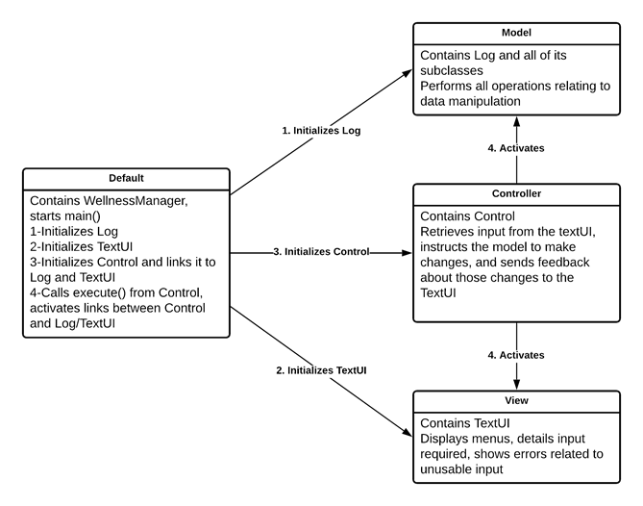
Subsystem Design
Notes:
Afzal

Slide 5
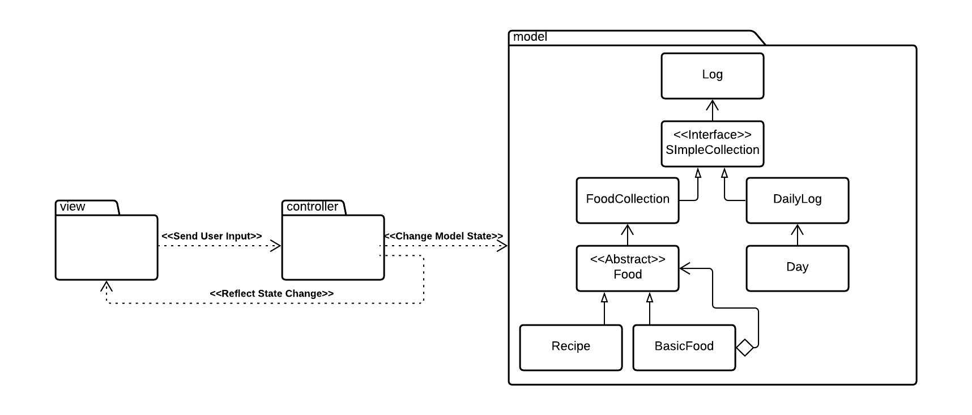
Model
Notes:
Seth
Collection IF
Composite pattern
Food object, super helpful
Leaf, sub-recipes, etc.

Slide 6
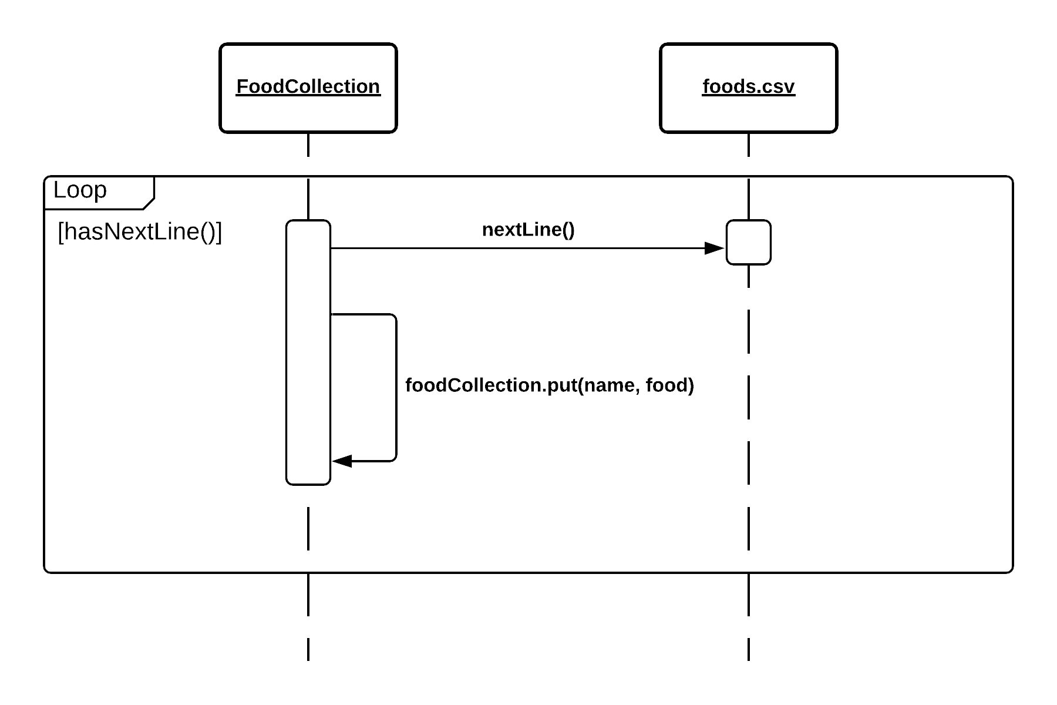
Sequence Diagram - Read/Build Food Collection
Notes:
Afzal
Talk about reading the csv
Talk about collection Interface and methods
Talk about functionality off food collection (read a file, create, save, add, remove, get, show)

Slide 7
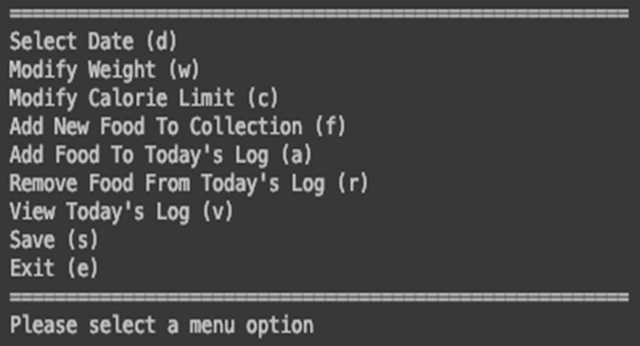
View/Control Subsystems
View
TextUI.java
Command Line Interface
Controller
Control.java
java.util.Scanner
Notes:
Stephen Morrissey

Slide 8
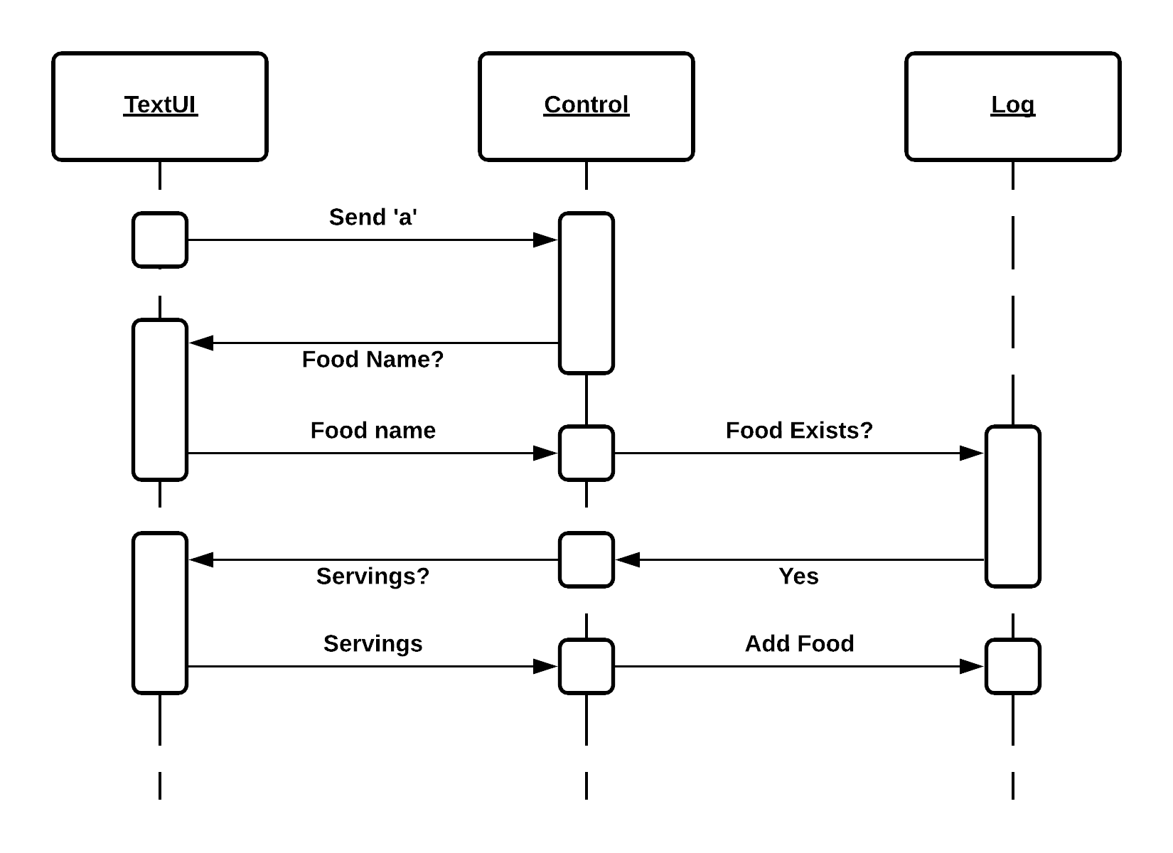
Sequence Diagram - Add Food To Day
Notes:
Seth Talk through adding to the log.

Slide 9
Demo
Notes:
Steve Jackling

